Slide 1
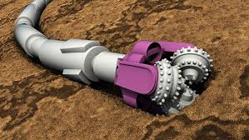
Twin Digital Autonomous System For Directional Drilling
UMAT Drillbotics

Slide 2
Introduction
Drilling is the primary method used to extract hydrocarbons from the Earth's subsurface.
In the oil and gas industry, both vertical and directional drilling methods have been employed to intersect reservoirs and extract hydrocarbons.
Each method comes with its own set of advantages and disadvantages.

Slide 3
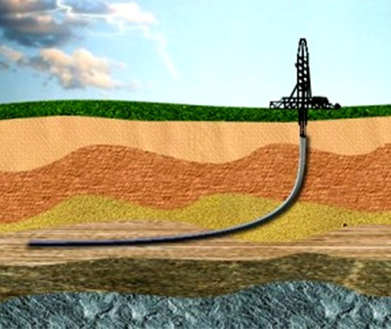
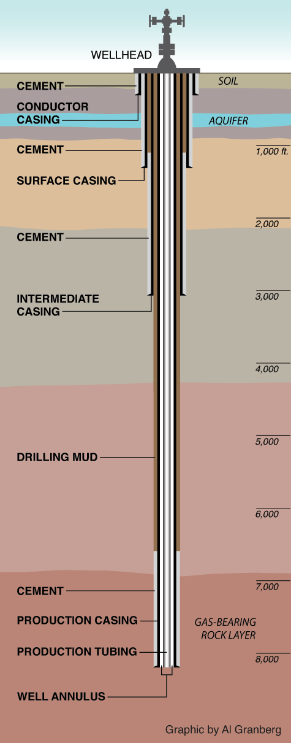
Vertical VS Directional Drilling
Directional drilling
Vertical drilling

Slide 4
Vertical VS Directional Drilling Continued
Table 1: Comparison of Vertical and Directional Drilling
Aspect | Vertical Drilling | Directional Drilling
Access to remote reserves | Limited | Enhanced
Reservoir contact | Limited | Maximized
Geologic flexibility | Limited | Increased
Operational efficiency | Good | Improved
Environmental impact | Potential disturbance | Reduced footprint
Wellbore stability | High | Enhanced
Cost effectiveness | Applicable for simple projects | Potential cost savings
Safety hazards | Standard | Reduced Risk

Slide 5
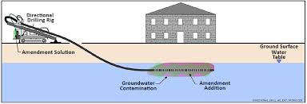
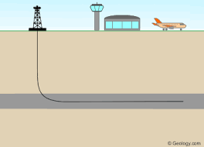
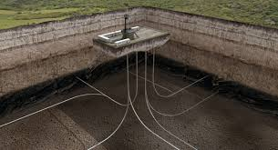
Benefits of Directional Drilling
The oil and gas industry increasingly utilizes directional drilling for its projects due to significant benefits including;
Access to remote reserves
Increased reservoir contact
Improved productivity.
Flexibility in navigating challenging geologic formations and reduces environmental impact.

Slide 6
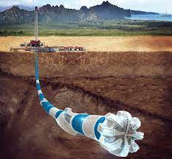
Automation and Efficiency
Directional drilling can be complex and costly, but automation optimizes operations, enhancing efficiency and safety by reducing human involvement in hazardous activities.

Slide 7
Proactive Planning and Automation
Proactive planning and automation are crucial for minimizing costs in directional drilling. Our project involves;
Creating a digital twin of the drilling process
Automating it while considering human input.
This approach surpasses conventional software solutions by integrating;
Well planning
Automatic and efficient selection of drilling equipment(Drill string).
Precise well steering.

Slide 8
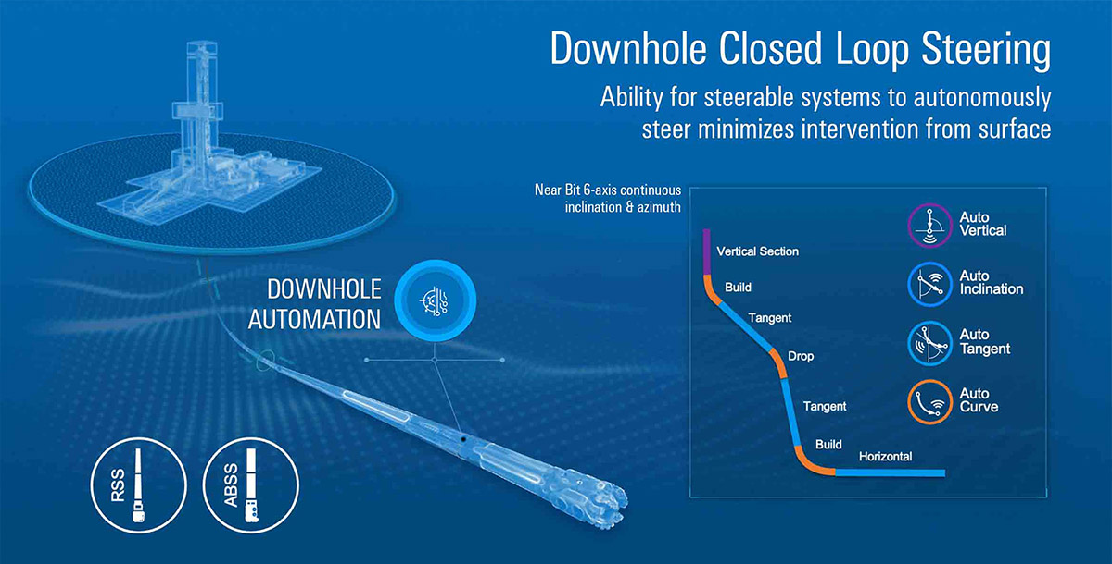
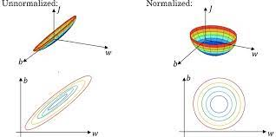
Leveraging Advanced Technologies and AI
By leveraging digital twins, real-time data analysis, and artificial intelligence (AI), our system simulates and optimizes the directional drilling process before operations begin. This comprehensive approach, combined with our own derived efficient equipment selection algorithms, reduces costs, improves efficiency, and enhances safety by minimizing errors and intervention.
Normalization of data for drill string selection

Slide 9
Unlocking the Future of Drilling
Our virtual drilling system revolutionizes the oil and gas industry by leveraging advanced technologies, including digital twins, real-time data analysis, and artificial intelligence. With enhanced productivity, improved safety, and reduced costs, we are shaping a more efficient and sustainable future in drilling.
Join us on this transformative journey as we lead the way towards optimized operations and increased environmental responsibility.
Thank you

